Slide 1
Network intrusion detection
CAPSTONE PROJECT
Presented By:
Student Name- Sharfuddin
College Name- RD Engineering College (Affiliated to AKTU)
Department- Computer Science and Engineering
4 AICTE Student ID- STU6853778700e531750300551

Slide 2
OUTLINE
Problem Statement (Should not include solution)
Proposed System/Solution
System Development Approach (Technology Used)
Algorithm & Deployment
Result (Output Image)
Conclusion
GitHub Link
Future Scope
References

Slide 3
Problem Statement
In today’s digital landscape, cyber-attacks pose a significant threat to network security. Traditional rule-based intrusion detection systems struggle to adapt to evolving attack patterns, often resulting in delayed responses or missed threats.
This project aims to develop a machine learning-based Network Intrusion Detection System (NIDS) that can:
- Analyze network traffic data in real time,
- Detect and classify various types of cyber-attacks such as DoS, Probe, R2L, and U2R,
- Accurately distinguish between normal and malicious activities,
- And provide early alerts to enhance network security and reduce response time.
Goal:
The goal is to build an intelligent, adaptable, and effective system to secure communication networks against emerging threats.

Slide 4
Proposed Solution
To build an effective machine learning-based Network Intrusion Detection System (NIDS) that detects malicious network activity using automated model building and evaluation.
1. Dataset Integration:
- Imported the network intrusion dataset into IBM Watsonx Studio.
2. AutoAI Pipeline Creation:
- Utilized IBM AutoAI to automate:
- Data preprocessing
- Feature engineering
- Model selection
- Hyperparameter optimization
3. Model Training & Selection:
- AutoAI automatically trained multiple models and pipelines.
- Evaluated each based on accuracy, precision, recall, and F1-score.
- The Decision Tree Classifier (or best model as per AutoAI ranking) was selected for deployment.
4. Model Evaluation:
- Used AutoAI's built-in visual tools (e.g., ROC curves, confusion matrix, leaderboard) to assess model performance.
5. Export & Deployment:
- Exported the top-performing model pipeline for further integration or deployment.

Slide 5
System Approach
1. Development & Environment:
- Jupyter Notebook (from IBM) : Used for interactive development, model experimentation, and real-time feedback.
- Python : Core programming language for data processing, model building, and integration.
Machine Learning & AI: - IBM Watsonx.ai Studio: Automated machine learning platform (AutoAI) used for model selection, training, and evaluation.
3. Data Storage & Management:
- IBM Cloud Storage: Scalable storage solution for datasets and model artifacts.
4. Core Libraries & Tools:
- Pandas & NumPy: For data manipulation and numerical operations.
- Scikit-learn: For model development, evaluation, and hyperparameter tuning.
- XGBoost: For advanced boosting techniques, improving model accuracy.

Slide 6
Algorithm & Deployment
Algotithm Selection:
We selected the Decision Tree Classifier, a supervised learning algorithm that splits data based on feature values to form a tree-like decision structure. Using IBM Watsonx AutoAI, several models were automatically tested, and the Decision Tree was selected due to its high accuracy, interpretability, and suitability for the classification task in a Network Intrusion Detection System (NIDS).
Data Input:
The algorithm uses engineered features extracted from network traffic data.Important input features include:
- Flow duration
- Packet lengths
- Source/Destination bytes
These features help the model distinguish between normal and malicious network behavior.
Training Process:
- Separate training and testing datasets were used.
- The training dataset was fed into IBM AutoAI, which:
- Handled feature selection and scaling.
- Performed automated pipeline generation and hyperparameter tuning.
- Evaluated models using built-in validation.
Prediction Process:
- After training the best-performing pipeline was used to make predictions on the external testing dataset.
- The model classifies each network traffic record as Normal or Intrusion.

Slide 7
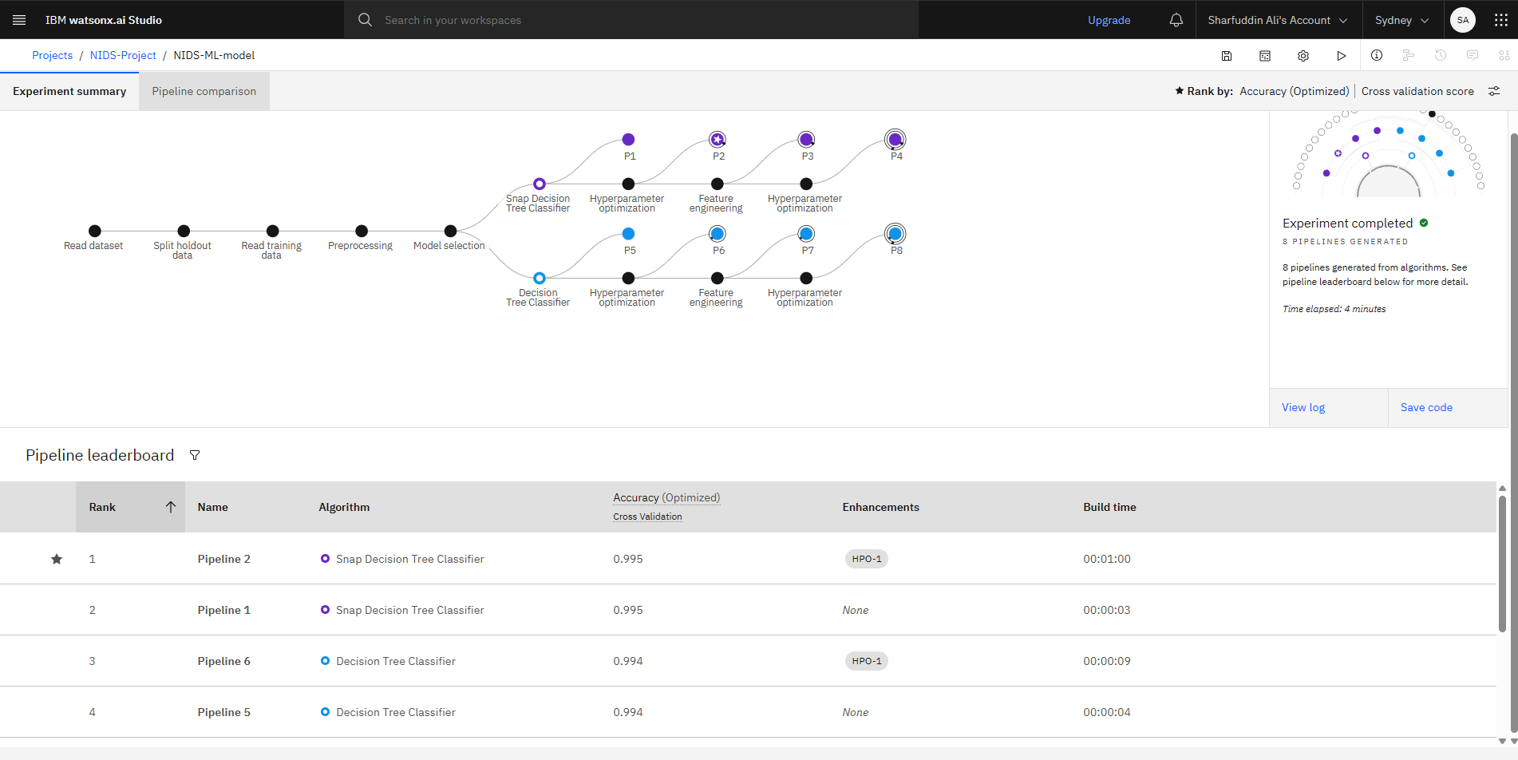
Result
Top pipeline performance:
Pipeline 2 achieved highest accuracy of 0.995 (Approx), showing the effectiveness of hyperparameter optimization.
Pipeline 1 also scored 0.995, but without HPO, suggesting room for further improvements

Slide 8
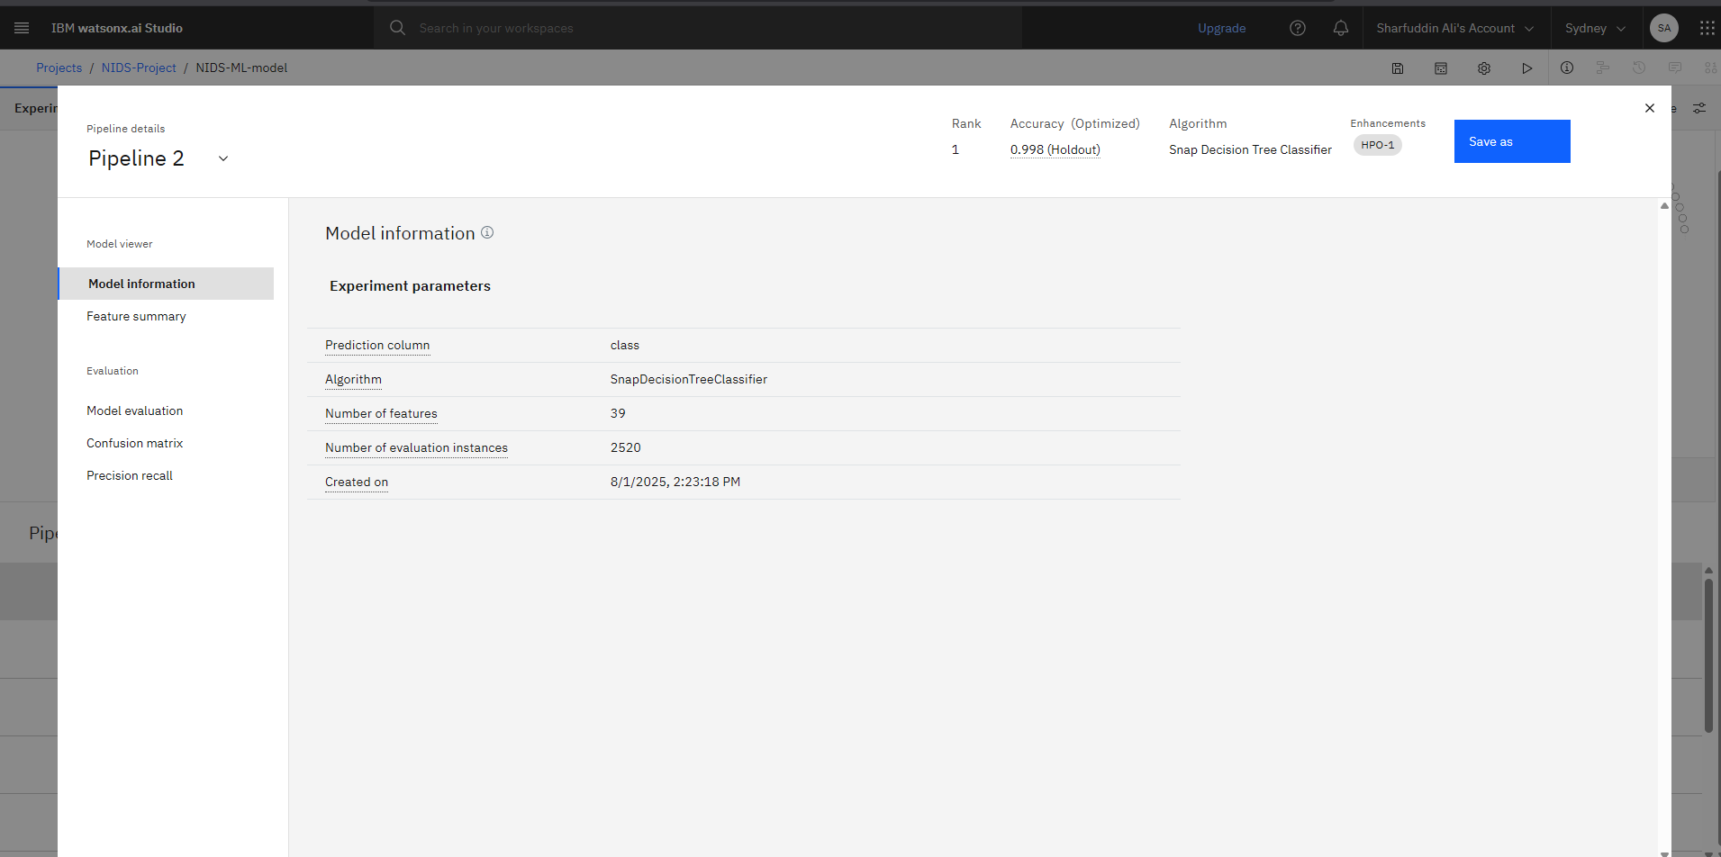
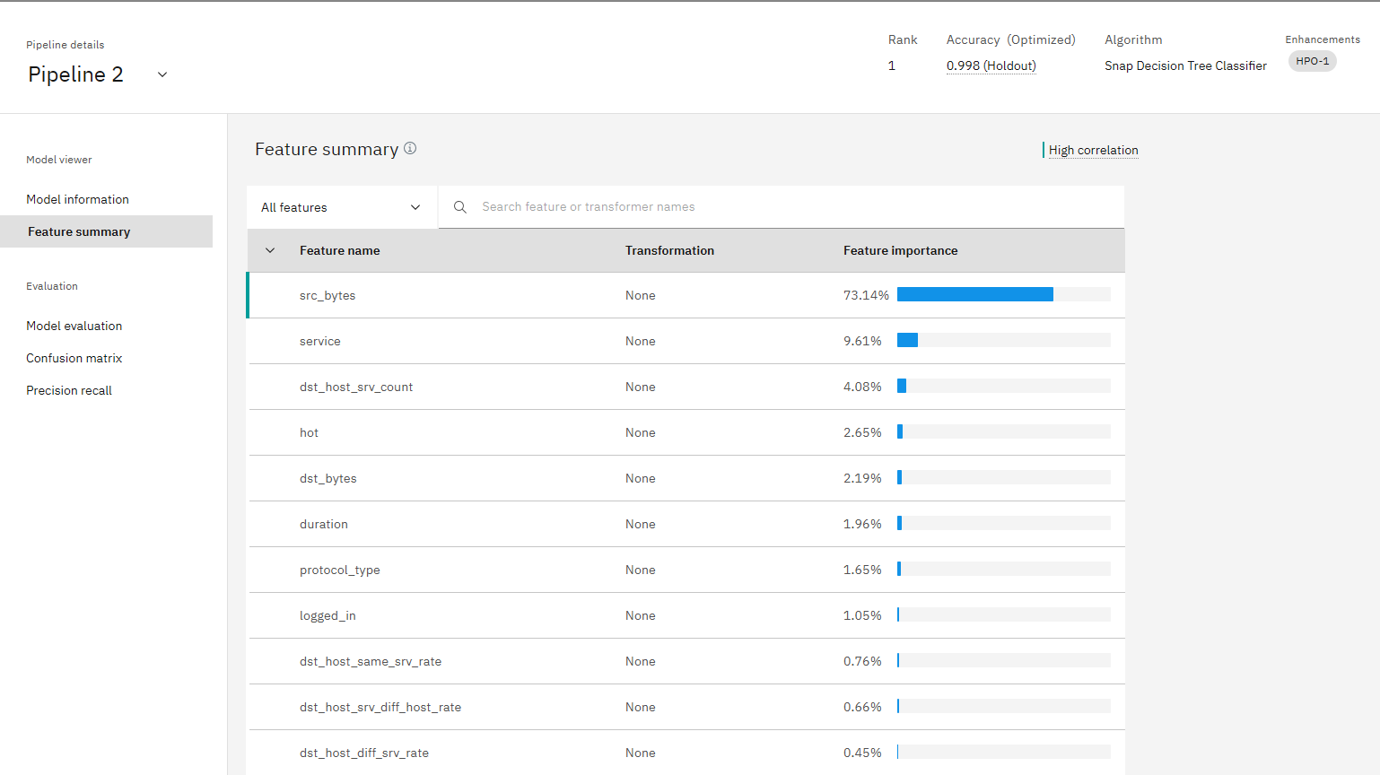
Result
Key model information:
Algorithm: Snap Decision Tree Classifier
Optimized Accuracy: 0.998(using holdout data)
Features used: 39 features
Evaluation Instances: 2,520 instances
Feature Importance Overview
- Top features:
- src_bytes (73.14%) is the most important feature,
indicating that the amount of data transferred is a key
factor in detecting intrusions.
- service (9.61%) and dst_host_srv_count (4.08%) also play
significant roles.

Slide 9
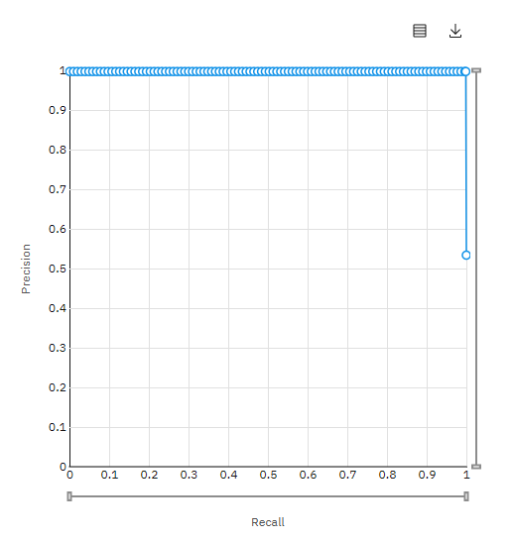
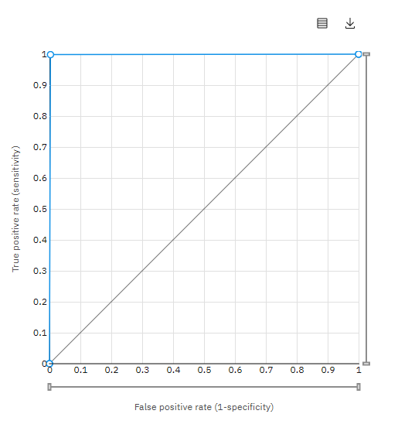
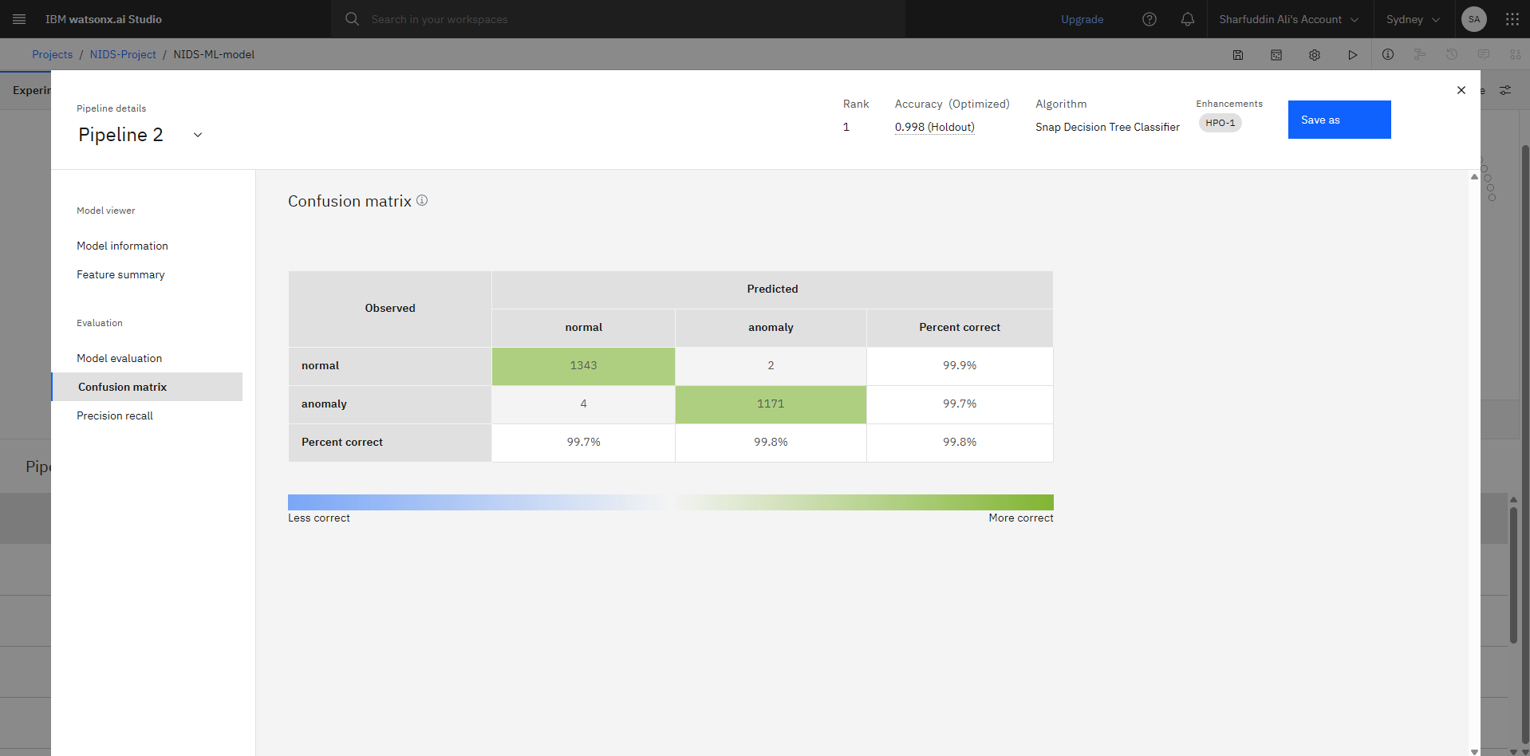
Result
ROC Curve:
- The ROC curve indicates a
high true positive rate and
low false positive rate,
showing the model's strong
ability to distinguish between
benign and malicious traffic.
Confusion matrix
- Normal Traffic: The model correctly predicted 99.9% of
normal traffic as normal (1343 correct predictions, 2
misclassification).
- Anomalies: The model correctly identified 99.7% of
anomalies(1171 correct predictions, 4 misclassifications).
Precision-Recall Curve
- The precision-Recall curve
shows the model’s ability to
detect intrusions with high
precision and recall, ensuring
minimal false positives and
high detection rate,

Slide 10
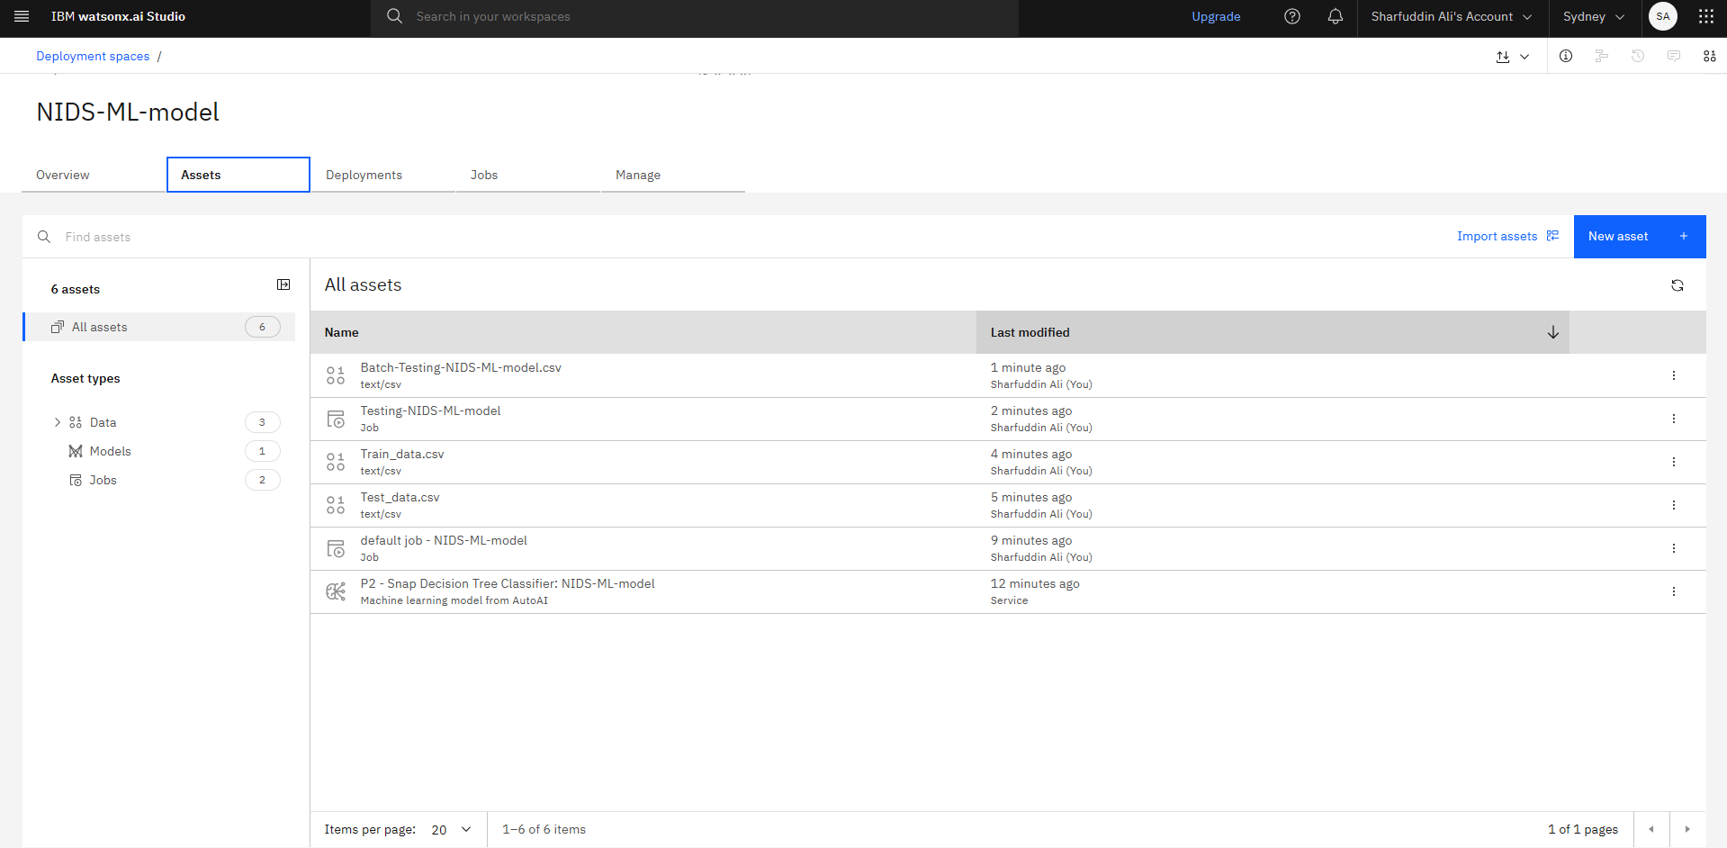
Result
Assets Overview
- The screenshot shows the
assets used for the NIDS
model, including training
data, testing data and the
model used for predictions.
- The P2-Snap Decision Tree
Classifier is the one used for
batch testing and
predictions.
- Two separate datasets were
used for training and testing.

Slide 11
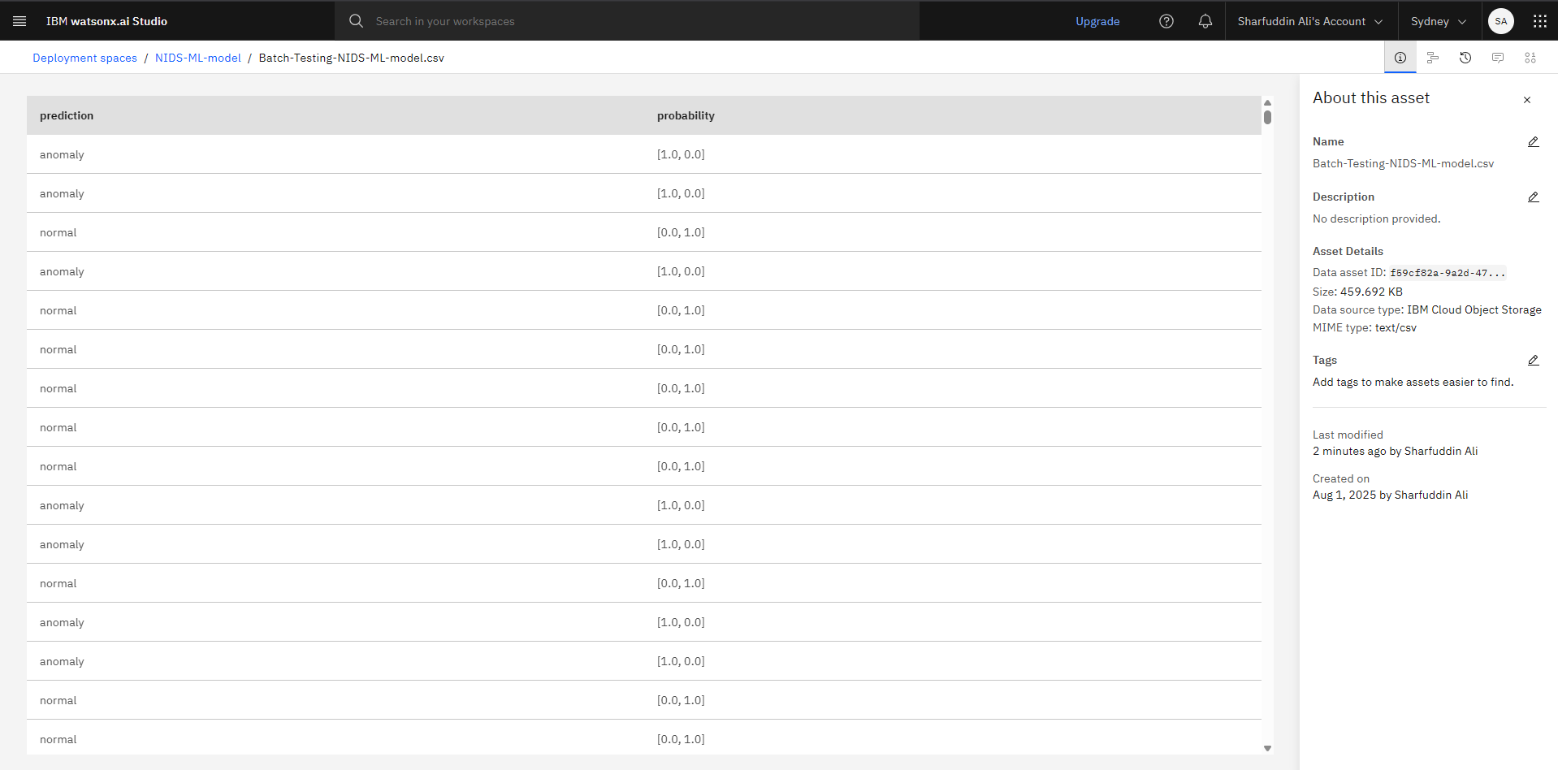
Result
Batch Prediction Results
- The model predicts
normal or anomaly with
high confidence
(probabilities close to
1.0), showing strong
performance in
classifying network
traffic.

Slide 12
Conclusion
Model Performance:
The Snap Decision Tree Classifier achieved an optimized accuracy of 0.998 in classifying network traffic into normal and anomaly categories, showing strong performance in distinguishing normal and malicious traffic.
Dataset and Testing:
The model was trained on a separate training dataset and tested on a distinct testing dataset, ensuring unbiased evaluation and minimizing data leakage.
Key Features:
The model heavily relied on features such as source bytes (src_bytes) and service type, which were crucial in making accurate predictions about netwok traffic.
Evaluation Metrics:
The ROC curve, confusion matrix, and precision-recall curve all indicated high precision, recall, and overall performance , with the model effectively detecting both normal traffic and anomalies.

Slide 13
IBM Certifications
Project GitHub Link :- https://github.com/Sharfuddin0047/IBM-cloud-Network-Intrusion-Detection

Slide 14
Future scope
Enhanced Feature Engineering
Incorporate additional data sources like network traffic logs and system metrics for better detection.
Advanced Models:
Explore ensemble learning or deep learning models to improve detection accuracy and handle complex attacks.
Real-time Detection:
Deploy the model for real-time monitoring and integrate online learning for continuous adaption.
Integration with Security Systems:
Integrate with existing firewalls and SEIM systems for automated threat response.
Ongoing Evaluation:
Perform hyperparameter tuning and test with real-world attack data for better performance

Slide 15
References
IBM Watsonx AutoAI Documentation:
IBM. (2023). IBM Watsonx AutoAI: Automating Machine Learning for Real-Time Decision Making.
Retrieved from https://www.ibm.com/products/watson-studio/autoai
Kaggle Dataset:
Sampada Basu.(2023), Network Intrusion Detection Dataset. Kaggle.
Retrieved from https://www.kaggle.com/datasets/sampadab17/network-intrusion-detection

Slide 16
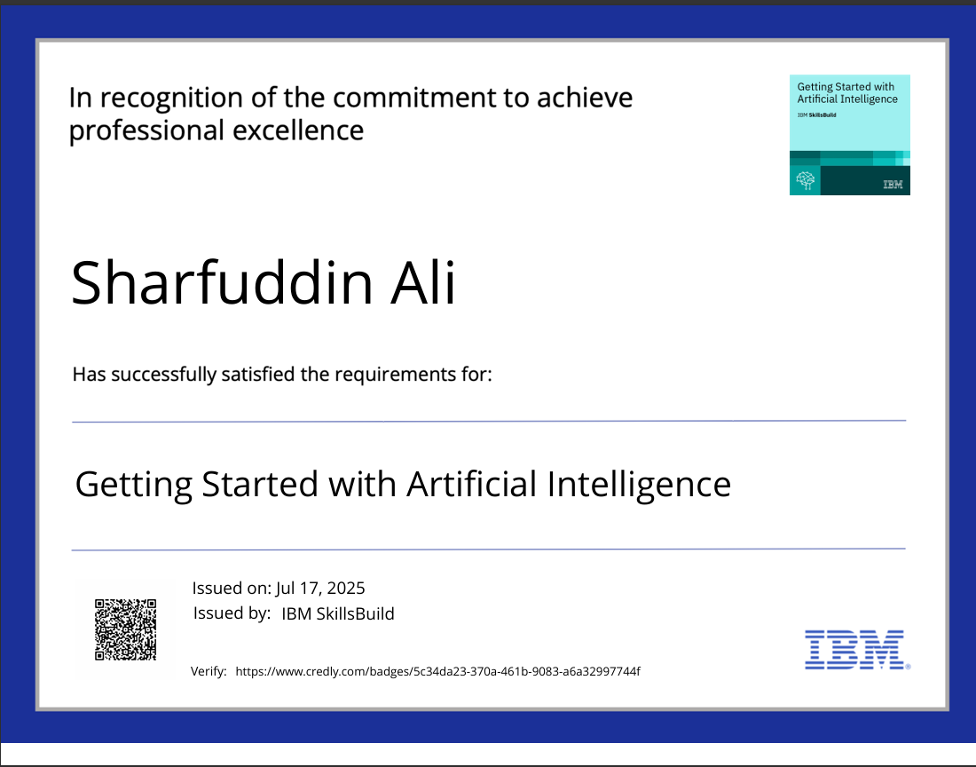
IBM Certifications
Screenshot/ credly certificate( getting started with AI)

Slide 17

IBM Certifications
Screenshot/ credly certificate( Journey to Cloud)

Slide 18
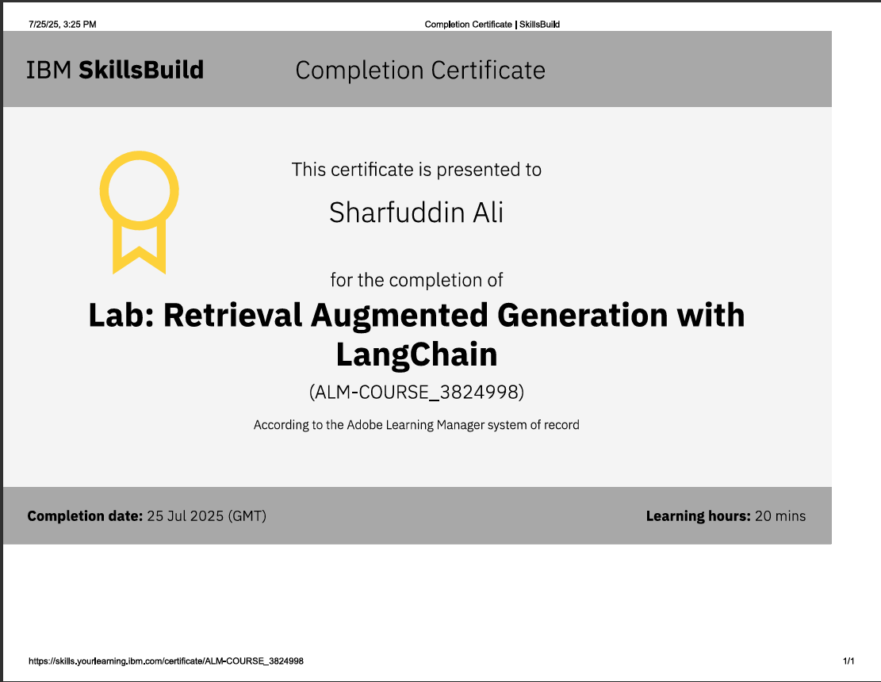
IBM Certifications
Screenshot/ credly certificate( RAG Lab)

Slide 19
THANK YOU

